Slide 1
Chapter 1: Introduction
Notes:
‹#›

Slide 2
Chapter 1: Introduction
What Operating Systems Do
Computer-System Organization
Computer-System Architecture
Operating-System Structure
Operating-System Operations
Process Management
Memory Management
Storage Management
Protection and Security
Kernel Data Structures
Computing Environments
Open-Source Operating Systems

Slide 3
Objectives
To describe the basic organization of computer systems
To provide a grand tour of the major components of operating systems
To give an overview of the many types of computing environments
To explore several open-source operating systems

Slide 4
What is an Operating System?
A program that acts as an intermediary between a user of a computer and the computer hardware
Operating system goals:
Execute user programs and make solving user problems easier
Make the computer system convenient to use
Use the computer hardware in an efficient manner

Slide 5
Computer System Structure
Computer system can be divided into four components:
Hardware – provides basic computing resources
CPU, memory, I/O devices
Operating system
Controls and coordinates use of hardware among various applications and users
Application programs – define the ways in which the system resources are used to solve the computing problems of the users
Word processors, compilers, web browsers, database systems, video games
Users
People, machines, other computers

Slide 6
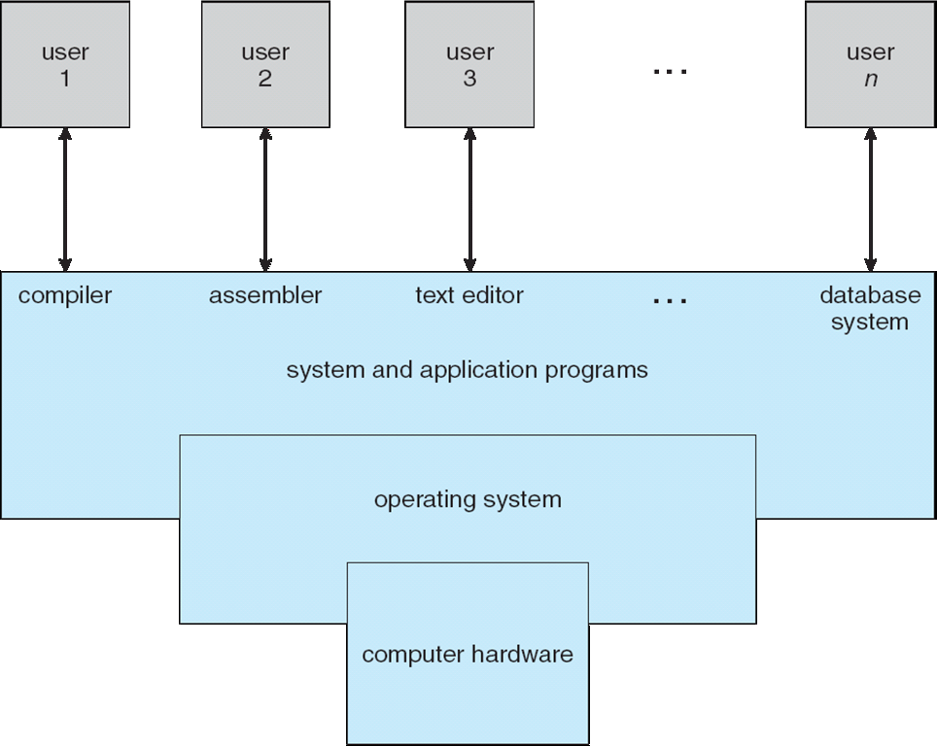
Four Components of a Computer System

Slide 7
What Operating Systems Do
Depends on the point of view
Users want convenience, ease of use and good performance
Don’t care about resource utilization
But shared computer such as mainframe or minicomputer must keep all users happy
Users of dedicate systems such as workstations have dedicated resources but frequently use shared resources from servers
Handheld computers are resource poor, optimized for usability and battery life
Some computers have little or no user interface, such as embedded computers in devices and automobiles

Slide 8
Operating System Definition
OS is a resource allocator
Manages all resources
Decides between conflicting requests for efficient and fair resource use
OS is a control program
Controls execution of programs to prevent errors and improper use of the computer

Slide 9
Operating System Definition (Cont.)
No universally accepted definition
“Everything a vendor ships when you order an operating system” is a good approximation
But varies wildly
“The one program running at all times on the computer” is the kernel.
Everything else is either
a system program (ships with the operating system) , or
an application program.

Slide 10
Computer Startup
bootstrap program is loaded at power-up or reboot
Typically stored in ROM or EPROM, generally known as firmware
Initializes all aspects of system
Loads operating system kernel and starts execution

Slide 11

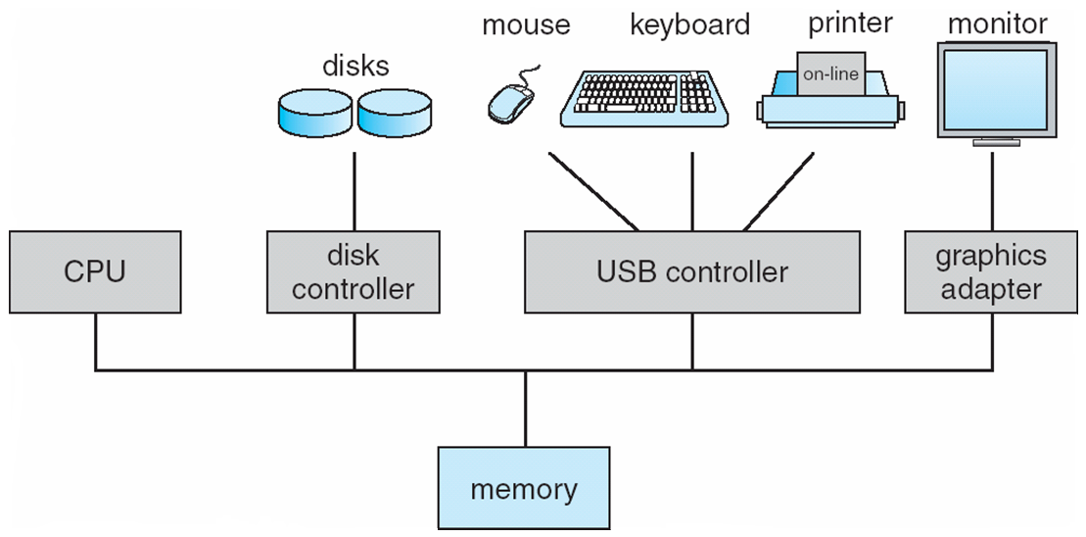
Computer System Organization
Not in Syllabus
Computer-system operation
One or more CPUs, device controllers connect through common bus providing access to shared memory
Concurrent execution of CPUs and devices competing for memory cycles

Slide 12
Computer-System Operation
Not in Syllabus
I/O devices and the CPU can execute concurrently
Each device controller is in charge of a particular device type
Each device controller has a local buffer
CPU moves data from/to main memory to/from local buffers
I/O is from the device to local buffer of controller
Device controller informs CPU that it has finished its operation by causing an interrupt

Slide 13
Common Functions of Interrupts
Not in Syllabus
Interrupt transfers control to the interrupt service routine generally, through the interrupt vector, which contains the addresses of all the service routines
Interrupt architecture must save the address of the interrupted instruction
A trap or exception is a software-generated interrupt caused either by an error or a user request
An operating system is interrupt driven

Slide 14
Interrupt Handling
Not in Syllabus
The operating system preserves the state of the CPU by storing registers and the program counter
Determines which type of interrupt has occurred:
polling
vectored interrupt system
Separate segments of code determine what action should be taken for each type of interrupt

Slide 15
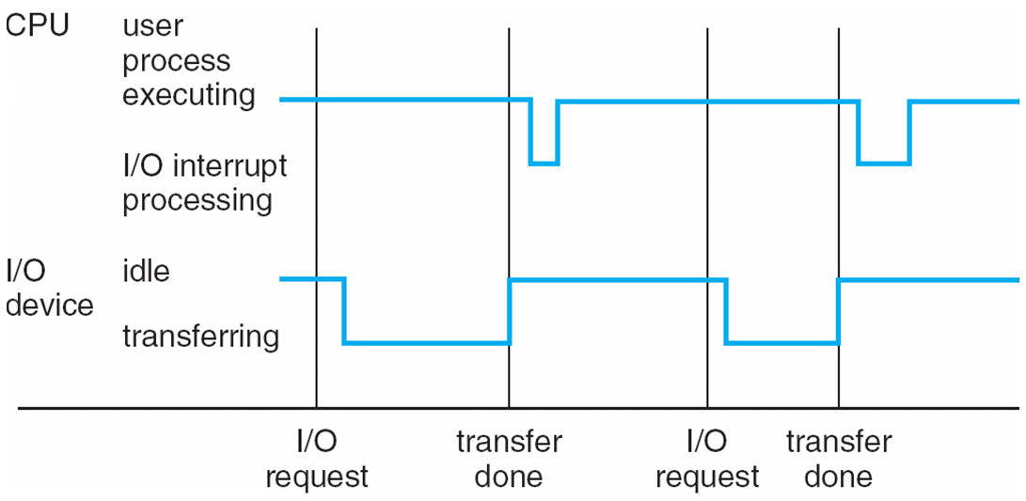
Interrupt Timeline
Not in Syllabus

Slide 16
I/O Structure
Not in Syllabus
After I/O starts, control returns to user program only upon I/O completion
Wait instruction idles the CPU until the next interrupt
Wait loop (contention for memory access)
At most one I/O request is outstanding at a time, no simultaneous I/O processing
After I/O starts, control returns to user program without waiting for I/O completion
System call – request to the OS to allow user to wait for I/O completion
Device-status table contains entry for each I/O device indicating its type, address, and state
OS indexes into I/O device table to determine device status and to modify table entry to include interrupt

Slide 17
Storage Definitions and Notation Review
Not in Syllabus
The basic unit of computer storage is the bit. A bit can contain one of two values, 0 and 1. All other storage in a computer is based on collections of bits. Given enough bits, it is amazing how many things a computer can represent: numbers, letters, images, movies, sounds, documents, and programs, to name a few. A byte is 8 bits, and on most computers it is the smallest convenient chunk of storage. For example, most computers don’t have an instruction to move a bit but do have one to move a byte. A less common term is word, which is a given computer architecture’s native unit of data. A word is made up of one or more bytes. For example, a computer that has 64-bit registers and 64-bit memory addressing typically has 64-bit (8-byte) words. A computer executes many operations in its native word size rather than a byte at a time.
Computer storage, along with most computer throughput, is generally measured and manipulated in bytes and collections of bytes.
A kilobyte, or KB, is 1,024 bytes
a megabyte, or MB, is 1,024² bytes
a gigabyte, or GB, is 1,024³ bytes
a terabyte, or TB, is 1,024⁴ bytes
a petabyte, or PB, is 1,024⁵ bytes
Computer manufacturers often round off these numbers and say that a megabyte is 1 million bytes and a gigabyte is 1 billion bytes. Networking measurements are an exception to this general rule; they are given in bits (because networks move data a bit at a time).

Slide 18
Storage Structure
Not in Syllabus
Main memory – only large storage media that the CPU can access directly
Random access
Typically volatile
Secondary storage – extension of main memory that provides large nonvolatile storage capacity
Hard disks – rigid metal or glass platters covered with magnetic recording material
Disk surface is logically divided into tracks, which are subdivided into sectors
The disk controller determines the logical interaction between the device and the computer
Solid-state disks – faster than hard disks, nonvolatile
Various technologies
Becoming more popular

Slide 19
Storage Hierarchy
Not in Syllabus
Storage systems organized in hierarchy
Speed
Cost
Volatility
Caching – copying information into faster storage system; main memory can be viewed as a cache for secondary storage
Device Driver for each device controller to manage I/O
Provides uniform interface between controller and kernel

Slide 20
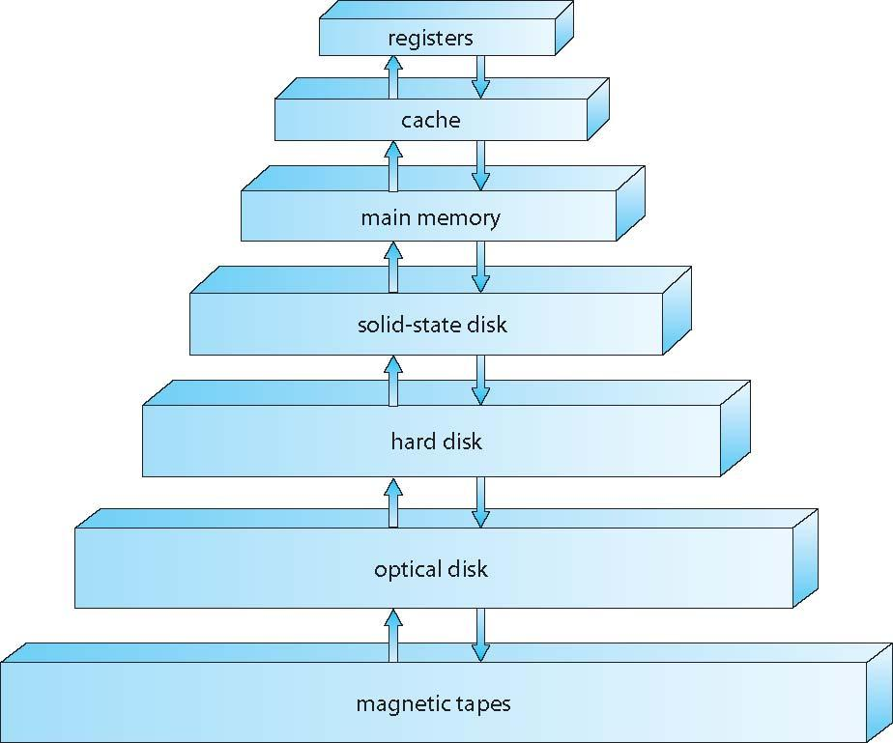
Storage-Device Hierarchy
Not in Syllabus

Slide 21
Caching
Not in Syllabus
Important principle, performed at many levels in a computer (in hardware, operating system, software)
Information in use copied from slower to faster storage temporarily
Faster storage (cache) checked first to determine if information is there
If it is, information used directly from the cache (fast)
If not, data copied to cache and used there
Cache smaller than storage being cached
Cache management important design problem
Cache size and replacement policy

Slide 22
Direct Memory Access Structure
Not in Syllabus
Used for high-speed I/O devices able to transmit information at close to memory speeds
Device controller transfers blocks of data from buffer storage directly to main memory without CPU intervention
Only one interrupt is generated per block, rather than the one interrupt per byte

Slide 23
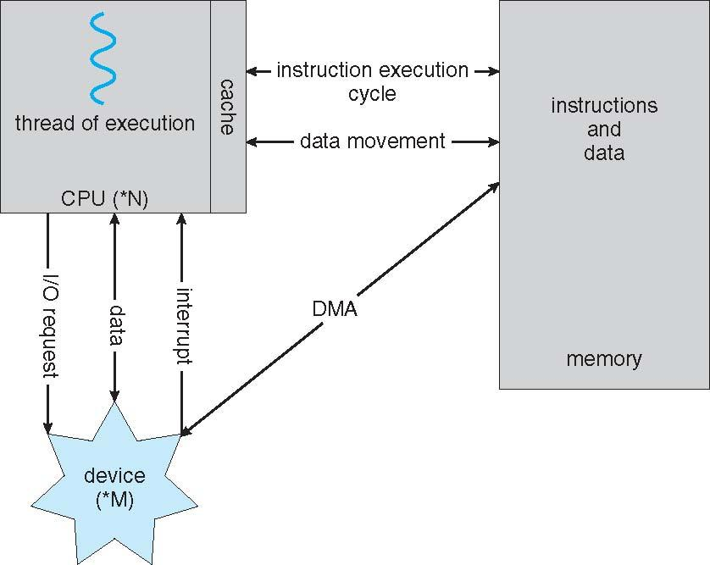
How a Modern Computer Works
Not in Syllabus
A von Neumann architecture

Slide 24
Computer-System Architecture
Not in Syllabus
Most systems use a single general-purpose processor
Most systems have special-purpose processors as well
Multiprocessors systems growing in use and importance
Also known as parallel systems, tightly-coupled systems
Advantages include:
Increased throughput
Economy of scale
Increased reliability – graceful degradation or fault tolerance
Two types:
Asymmetric Multiprocessing – each processor is assigned a specie task.
Symmetric Multiprocessing – each processor performs all tasks

Slide 25
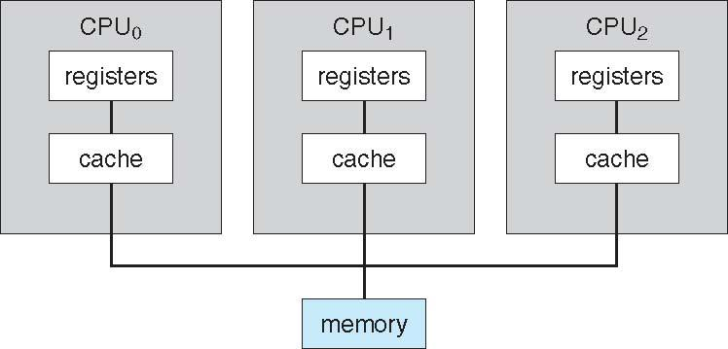
Symmetric Multiprocessing Architecture
Not in Syllabus

Slide 26
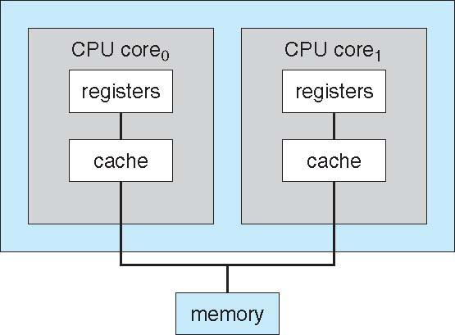
A Dual-Core Design
Not in Syllabus
Multi-chip and multicore
Systems containing all chips
Chassis containing multiple separate systems

Slide 27
Clustered Systems
Not in Syllabus
Like multiprocessor systems, but multiple systems working together
Usually sharing storage via a storage-area network (SAN)
Provides a high-availability service which survives failures
Asymmetric clustering has one machine in hot-standby mode
Symmetric clustering has multiple nodes running applications, monitoring each other
Some clusters are for high-performance computing (HPC)
Applications must be written to use parallelization
Some have distributed lock manager (DLM) to avoid conflicting operations

Slide 28
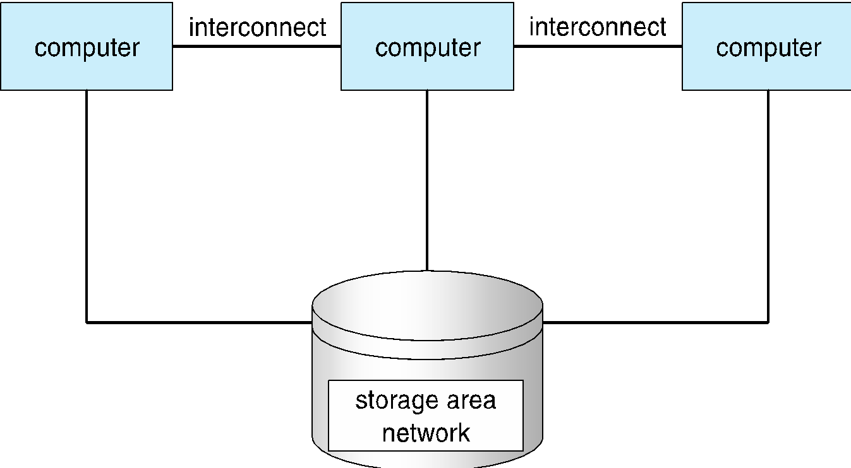
Clustered Systems
Not in Syllabus

Slide 29
Operating System Structure
Multiprogramming (Batch system) needed for efficiency
Single user cannot keep CPU and I/O devices busy at all times
Multiprogramming organizes jobs (code and data) so CPU always has one to execute
A subset of total jobs in system is kept in memory
One job selected and run via job scheduling
When it has to wait (for I/O for example), OS switches to another job
Timesharing (multitasking) is logical extension in which CPU switches jobs so frequently that users can interact with each job while it is running, creating interactive computing
Response time should be < 1 second
Each user has at least one program executing in memory 🢡process
If several jobs ready to run at the same time 🢡 CPU scheduling
If processes don’t fit in memory, swapping moves them in and out to run
Virtual memory allows execution of processes not completely in memory

Slide 30
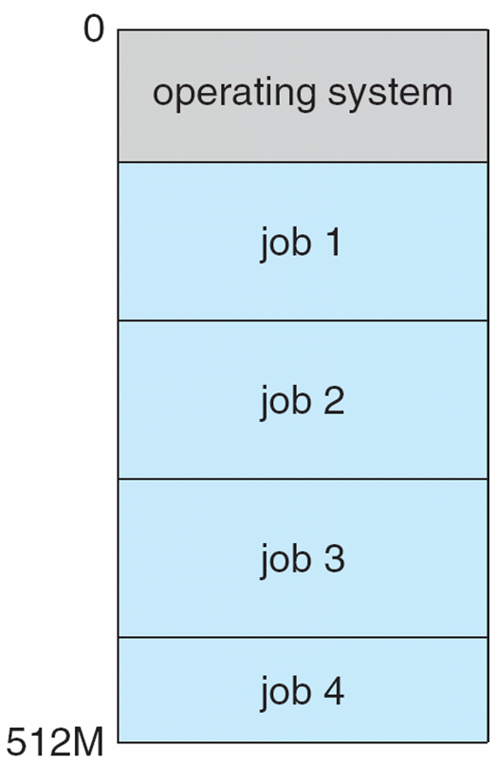
Memory Layout for Multiprogrammed System

Slide 31
Operating-System Operations
Interrupt driven (hardware and software)
Hardware interrupt by one of the devices
Software interrupt (exception or trap):
Software error (e.g., division by zero)
Request for operating system service
Other process problems include infinite loop, processes modifying each other or the operating system

Slide 32
Operating-System Operations (cont.)
Dual-mode operation allows OS to protect itself and other system components
User mode and kernel mode
Mode bit provided by hardware
Provides ability to distinguish when system is running user code or kernel code
Some instructions designated as privileged, only executable in kernel mode
System call changes mode to kernel, return from call resets it to user
Increasingly CPUs support multi-mode operations
i.e. virtual machine manager (VMM) mode for guest VMs

Slide 33
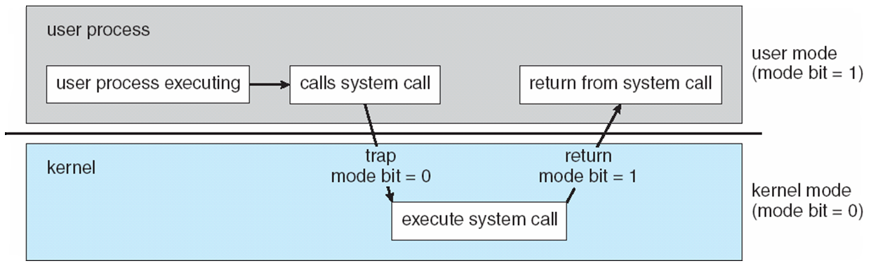
Transition from User to Kernel Mode
Timer to prevent infinite loop / process hogging resources
Timer is set to interrupt the computer after some time period
Keep a counter that is decremented by the physical clock.
Operating system set the counter (privileged instruction)
When counter zero generate an interrupt
Set up before scheduling process to regain control or terminate program that exceeds allotted time

Slide 34
Process Management
A process is a program in execution. It is a unit of work within the system. Program is a passive entity, process is an active entity.
Process needs resources to accomplish its task
CPU, memory, I/O, files
Initialization data
Process termination requires reclaim of any reusable resources
Single-threaded process has one program counter specifying location of next instruction to execute
Process executes instructions sequentially, one at a time, until completion
Multi-threaded process has one program counter per thread
Typically system has many processes, some user, some operating system running concurrently on one or more CPUs
Concurrency by multiplexing the CPUs among the processes / threads

Slide 35
Process Management Activities
The operating system is responsible for the following activities in connection with process management:
Creating and deleting both user and system processes
Suspending and resuming processes
Providing mechanisms for process synchronization
Providing mechanisms for process communication
Providing mechanisms for deadlock handling

Slide 36
Memory Management
To execute a program all (or part) of the instructions must be in memory
All (or part) of the data that is needed by the program must be in memory.
Memory management determines what is in memory and when
Optimizing CPU utilization and computer response to users
Memory management activities
Keeping track of which parts of memory are currently being used and by whom
Deciding which processes (or parts thereof) and data to move into and out of memory
Allocating and deallocating memory space as needed

Slide 37
Storage Management
OS provides uniform, logical view of information storage
Abstracts physical properties to logical storage unit - file
Each medium is controlled by device (i.e., disk drive, tape drive)
Varying properties include access speed, capacity, data-transfer rate, access method (sequential or random)
File-System management
Files usually organized into directories
Access control on most systems to determine who can access what
OS activities include
Creating and deleting files and directories
Primitives to manipulate files and directories
Mapping files onto secondary storage
Backup files onto stable (non-volatile) storage media

Slide 38
Mass-Storage Management
Usually disks used to store data that does not fit in main memory or data that must be kept for a “long” period of time
Proper management is of central importance
Entire speed of computer operation hinges on disk subsystem and its algorithms
OS activities
Free-space management
Storage allocation
Disk scheduling
Some storage need not be fast
Tertiary storage includes optical storage, magnetic tape
Still must be managed – by OS or applications
Varies between WORM (write-once, read-many-times) and RW (read-write)

Slide 39
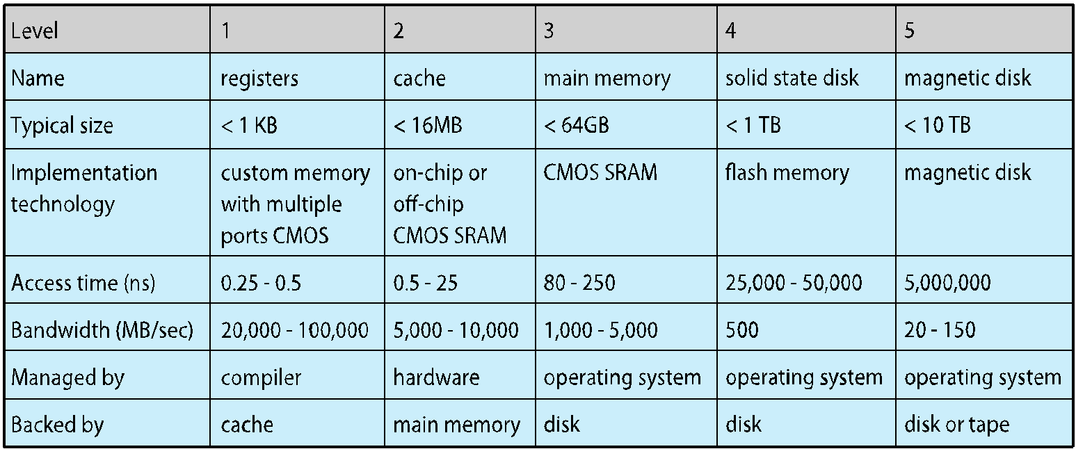
Performance of Various Levels of Storage
Movement between levels of storage hierarchy can be explicit or implicit

Slide 40
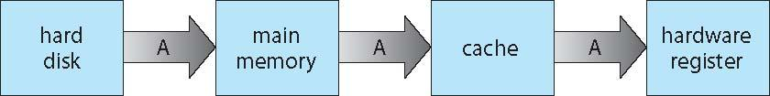
Migration of data “A” from Disk to Register
Multitasking environments must be careful to use most recent value, no matter where it is stored in the storage hierarchy
Multiprocessor environment must provide cache coherency in hardware such that all CPUs have the most recent value in their cache
Distributed environment situation even more complex
Several copies of a datum can exist
Various solutions covered in Chapter 17

Slide 41
I/O Subsystem
One purpose of OS is to hide peculiarities of hardware devices from the user
I/O subsystem responsible for
Memory management of I/O including buffering (storing data temporarily while it is being transferred), caching (storing parts of data in faster storage for performance), spooling (the overlapping of output of one job with input of other jobs)
General device-driver interface
Drivers for specific hardware devices

Slide 42
Protection and Security
Protection – any mechanism for controlling access of processes or users to resources defined by the OS
Security – defense of the system against internal and external attacks
Huge range, including denial-of-service, worms, viruses, identity theft, theft of service
Systems generally first distinguish among users, to determine who can do what
User identities (user IDs, security IDs) include name and associated number, one per user
User ID then associated with all files, processes of that user to determine access control
Group identifier (group ID) allows set of users to be defined and controls managed, then also associated with each process, file
Privilege escalation allows user to change to effective ID with more rights

Slide 43
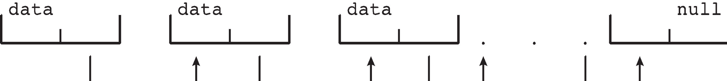
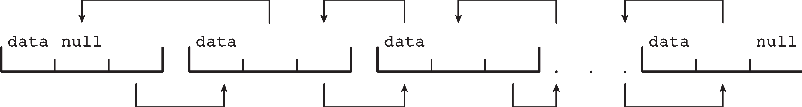
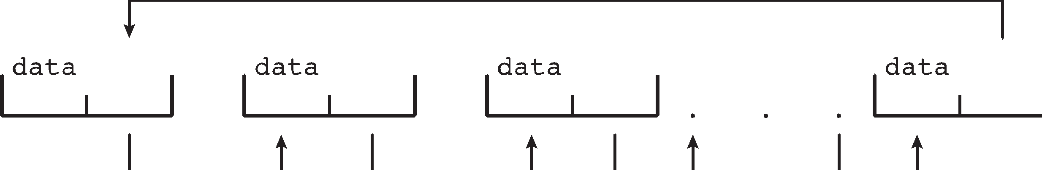
Kernel Data Structures
Not in Syllabus
Many similar to standard programming data structures
Singly linked list
Doubly linked list
Circular linked list

Slide 44
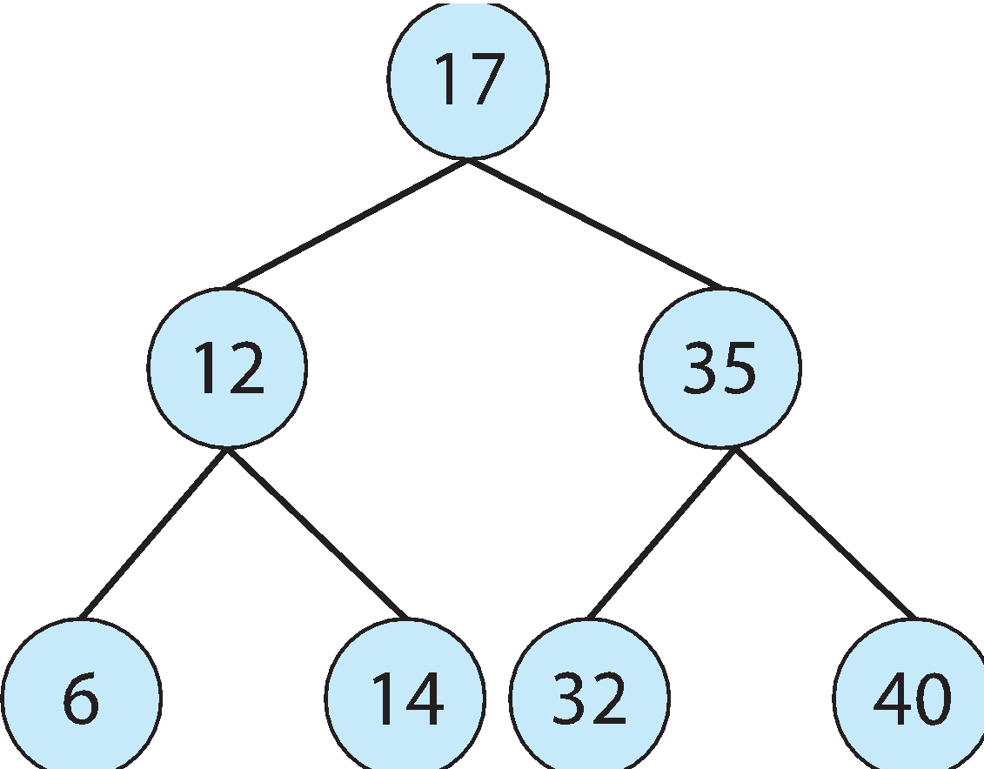
Kernel Data Structures
Not in Syllabus
Binary search tree left <= right
Search performance is O(n)
Balanced binary search tree is O(lg n)

Slide 45
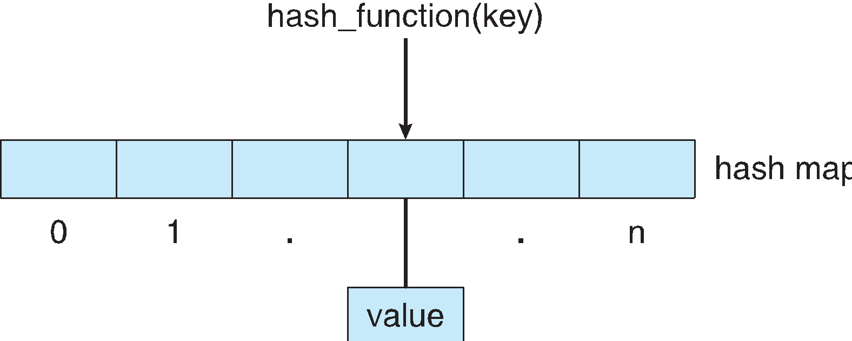
Kernel Data Structures
Not in Syllabus
Hash function can create a hash map
Bitmap – string of n binary digits representing the status of n items
Linux data structures defined in
include files <linux/list.h>, <linux/kfifo.h>, <linux/rbtree.h>

Slide 46
Computing Environments - Traditional
Not in Syllabus
Stand-alone general purpose machines
But blurred as most systems interconnect with others (i.e., the Internet)
Portals provide web access to internal systems
Network computers (thin clients) are like Web terminals
Mobile computers interconnect via wireless networks
Networking becoming ubiquitous – even home systems use firewalls to protect home computers from Internet attacks

Slide 47
Computing Environments - Mobile
Not in Syllabus
Handheld smartphones, tablets, etc
What is the functional difference between them and a “traditional” laptop?
Extra feature – more OS features (GPS, gyroscope)
Allows new types of apps like augmented reality
Use IEEE 802.11 wireless, or cellular data networks for connectivity
Leaders are Apple iOS and Google Android

Slide 48
Computing Environments – Distributed
Not in Syllabus
Distributed computiing
Collection of separate, possibly heterogeneous, systems networked together
Network is a communications path, TCP/IP most common
Local Area Network (LAN)
Wide Area Network (WAN)
Metropolitan Area Network (MAN)
Personal Area Network (PAN)
Network Operating System provides features between systems across network
Communication scheme allows systems to exchange messages
Illusion of a single system

Slide 49
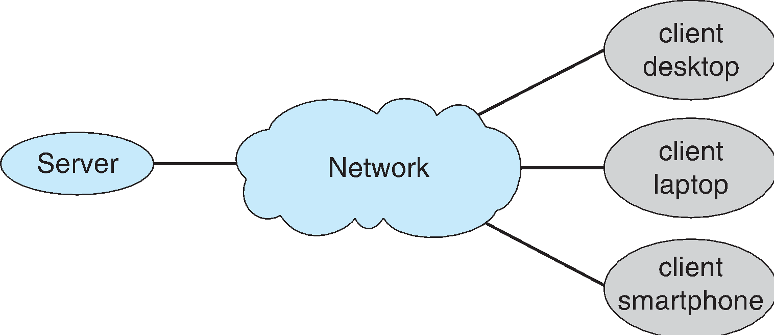
Computing Environments – Client-Server
Not in Syllabus
Client-Server Computing
Dumb terminals supplanted by smart PCs
Many systems now servers, responding to requests generated by clients
Compute-server system provides an interface to client to request services (i.e., database)
File-server system provides interface for clients to store and retrieve files

Slide 50
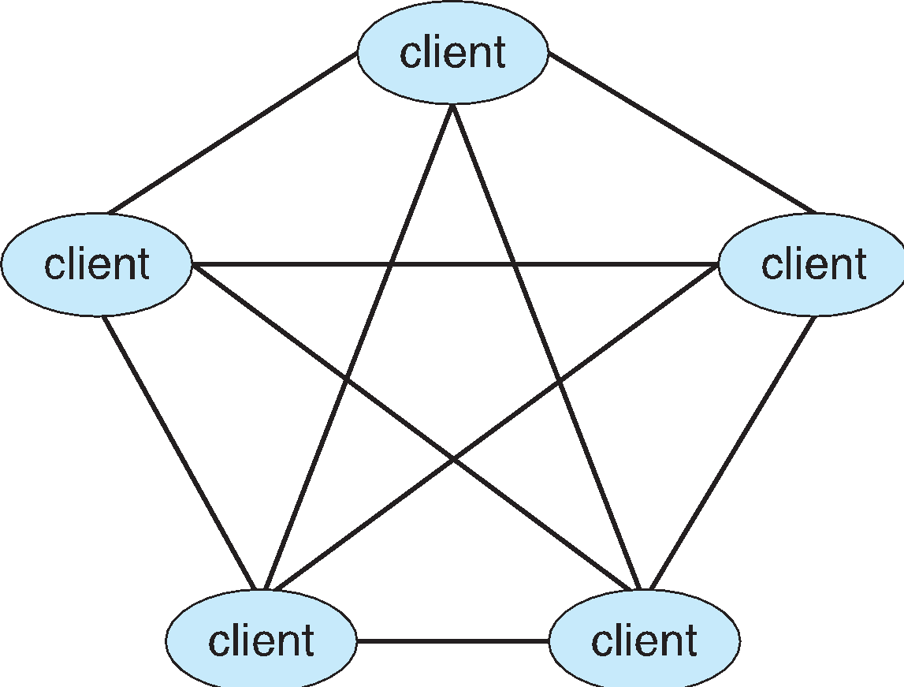
Computing Environments - Peer-to-Peer
Not in Syllabus
Another model of distributed system
P2P does not distinguish clients and servers
Instead all nodes are considered peers
May each act as client, server or both
Node must join P2P network
Registers its service with central lookup service on network, or
Broadcast request for service and respond to requests for service via discovery protocol
Examples include Napster and Gnutella, Voice over IP (VoIP) such as Skype

Slide 51
Computing Environments - Virtualization
Not in Syllabus
Allows operating systems to run applications within other OSes
Vast and growing industry
Emulation used when source CPU type different from target type (i.e. PowerPC to Intel x86)
Generally slowest method
When computer language not compiled to native code – Interpretation
Virtualization – OS natively compiled for CPU, running guest OSes also natively compiled
Consider VMware running WinXP guests, each running applications, all on native WinXP host OS
VMM (virtual machine Manager) provides virtualization services

Slide 52
Computing Environments - Virtualization
Not in Syllabus
Use cases involve laptops and desktops running multiple OSes for exploration or compatibility
Apple laptop running Mac OS X host, Windows as a guest
Developing apps for multiple OSes without having multiple systems
QA testing applications without having multiple systems
Executing and managing compute environments within data centers
VMM can run natively, in which case they are also the host
There is no general purpose host then (VMware ESX and Citrix XenServer)

Slide 53
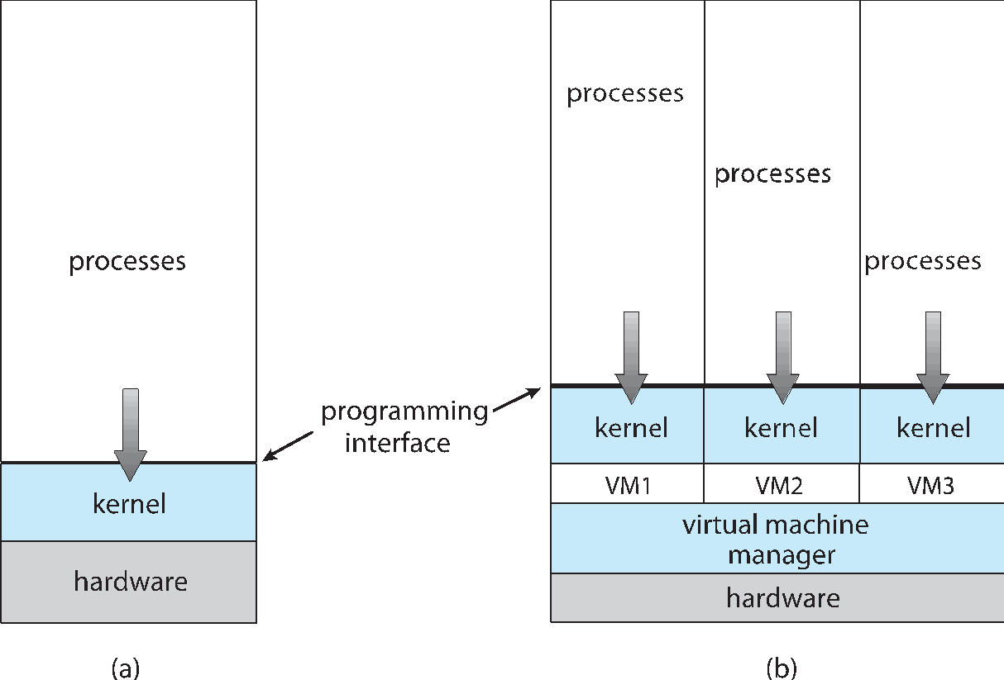
Computing Environments - Virtualization
Not in Syllabus

Slide 54
Computing Environments – Cloud Computing
Not in Syllabus
Delivers computing, storage, even apps as a service across a network
Logical extension of virtualization because it uses virtualization as the base for it functionality.
Amazon EC2 has thousands of servers, millions of virtual machines, petabytes of storage available across the Internet, pay based on usage
Many types
Public cloud – available via Internet to anyone willing to pay
Private cloud – run by a company for the company’s own use
Hybrid cloud – includes both public and private cloud components
Software as a Service (SaaS) – one or more applications available via the Internet (i.e., word processor)
Platform as a Service (PaaS) – software stack ready for application use via the Internet (i.e., a database server)
Infrastructure as a Service (IaaS) – servers or storage available over Internet (i.e., storage available for backup use)

Slide 55
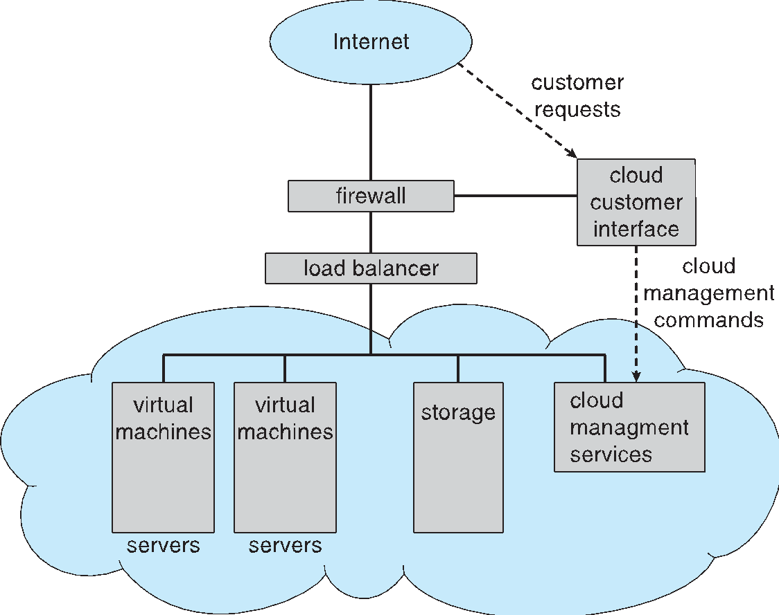
Computing Environments – Cloud Computing
Not in Syllabus
Cloud computing environments composed of traditional OSes, plus VMMs, plus cloud management tools
Internet connectivity requires security like firewalls
Load balancers spread traffic across multiple applications

Slide 56
Computing Environments – Real-Time Embedded Systems
Not in Syllabus
Real-time embedded systems most prevalent form of computers
Vary considerable, special purpose, limited purpose OS, real-time OS
Use expanding
Many other special computing environments as well
Some have OSes, some perform tasks without an OS
Real-time OS has well-defined fixed time constraints
Processing must be done within constraint
Correct operation only if constraints met

Slide 57
Open-Source Operating Systems
Not in Syllabus
Operating systems made available in source-code format rather than just binary closed-source
Counter to the copy protection and Digital Rights Management (DRM) movement
Started by Free Software Foundation (FSF), which has “copyleft” GNU Public License (GPL)
Examples include GNU/Linux and BSD UNIX (including core of Mac OS X), and many more
Can use VMM like VMware Player (Free on Windows), Virtualbox (open source and free on many platforms - http://www.virtualbox.com)
Use to run guest operating systems for exploration

Slide 58
End of Chapter 1
Notes:
‹#›

